Slide 1
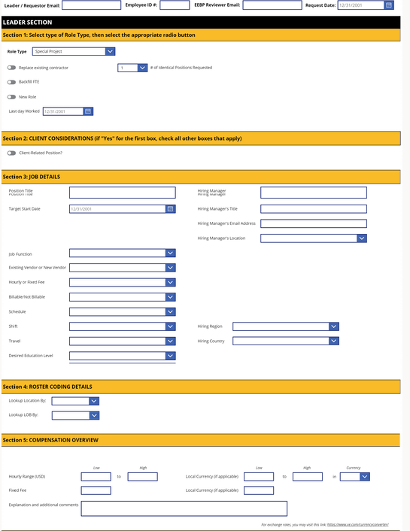
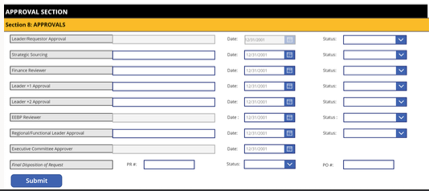

Alorica & PowerSuite
Customer Challenge
A leader in the worldwide call center industry approached us with a request to create an intuitive yet powerful digital form, which would allow multiple managers across teams to craft new positions in the organization. Additionally, to ensure swift approvals from managers, Affirma was asked to create an automated process to allow managers to approve changes to the form.
What We Did
Affirma produced a complete solution utilizing Microsoft PowerSuite, providing an engaging form coupled with an advanced automated approval flow; which drove internal process efficiency and management participation.
Created an “editing mode” link that allows users to interact with previously submitted versions of the form live.
Affirma built the form with “dynamic interaction” in mind. Entire sections show/hide depending on selected options. The form adapts to the appropriate context.

